Slide 1
NBAC TSC Slides 30 May 2024 Meeting

Slide 2
30 MAY 2024 NBAC TSC Agenda
1:00 NBAC Co-Chair Opening Remarks – Mr. Stephen Sullivan
Thomas & Kamran are not with us today
Work will commence soon on completing the PS02 update to Model Version 6.0
Dr. Renner is working on the companion NDR update for Model Version 6.0
NIEMOpen Reveal Summit preps are in progress
1:05 NIEM Management Office (NMO) Update – Ms. Katherine Escobar
NIEMOpen Reveal
Link to Website : https://niemopen.org/reveal
Ways Your Company Can Participate:
Reserve seats for your key staff to attend the conference.
Organize a team to participate in the hackathon, contact: Jane Harnad.
Sponsor the event early to secure one of the limited number of sponsor tables, contact: Jane Harnad.
MEP Registry: https://www.niem.gov/about-niem/message-exchange-package-mep-registry-repository
MEP Tool
Documentation
Link
Resources
NIEMOpen Repos
1:15 MEP Tool Demo – Aubrey Beach
1:30 NTAC Update – Dr. Scott Renner
CMF Tool: https://github.com/niemopen/cmftool
NDR draft: “ndr6-outline.md” at https://github.com/niemopen/niem-naming-design-rules/tree/dev
1:35 Communications & Outreach NMO Sub-Committee update – Paul Wormeli
1:40 Community Updates - all
1:45 Questions/Final Remarks

Slide 3
NIEMOPEN REVEAL STATUS
NIEMOpen Reveal: Data Standard, Redefining the International Information Landscape
Purpose
Dates: 18-20 Feb 2025
Location: National Press Club, Washington DC
Venue:
Ballroom – Plenary Sessions
2 Technical Breakout Tracks (Technical Primer & Technical Expert Training Tracks)
Draft agenda available
PGB approved seed money to reserve Ballroom on 19 Feb
11 April PGB Motion to secure remainder of NPC facilities - Approved
How funding event:
Registration Fees
Event Sponsorship

Slide 4
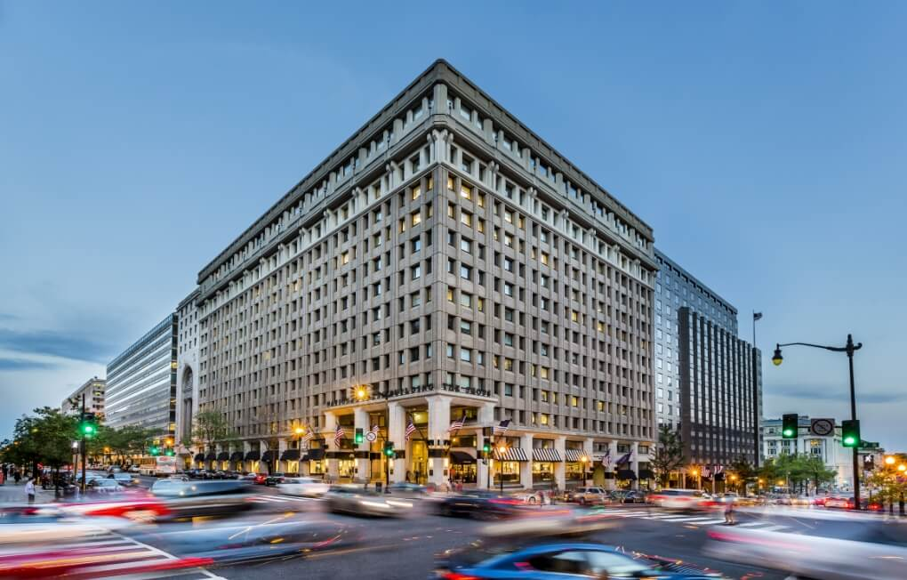

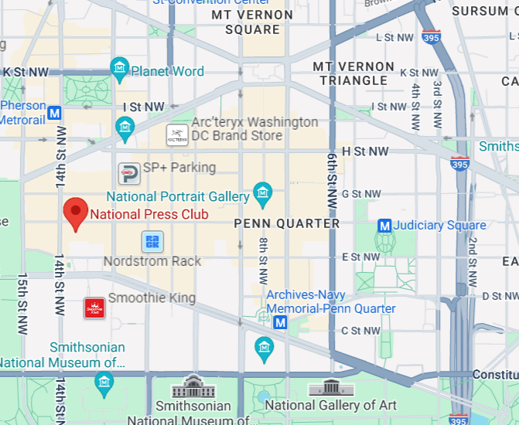

NIEMOpen reveal summit : 18-20 Feb 2025
Event Website: https://niemopen.org/reveal
Direct Registration Link: https://www.eventbrite.com/e/niemopen-reveal-training-summit-2025-tickets-890279729637
Homepage | National Press Club
Located in: National Press Building
Address: 529 14th St NW, Washington, DC 20045
Founded: March 29, 1908
Phone: (202) 662-7500

Slide 5








resources
Follow Us On Twitter
https://twitter.com/NIEMconnects?ref_src=twsrc%5Etfw
Katherine Escobar, katherine.b.escobar.civ@mail.mil, 7575-203-8631
Beth Smalley, beth.l.smalley.civ@mail.mil, 757-203-7177
Stephen Sullivan, stephen.m.sullivan14.ctr@mail.mil , 757-203-8619
https://www.niem.gov/
https://niemopen.org/
https://www.linkedin.com/groups/1903175/profile
Git Repos
NIEMOpen: https://github.com/niemopen/
NTAC TSC
https://github.com/niemopen/ntac-admin
NBAC TSC
https://github.com/niemopen/nbac-admin
NMO TSC
https://github.com/niemopen/nmo-admin
https://github.com/niemopen/nmo-training
NIEMOpen Slack Channel: https://niemopen.slack.com/
Mailing Lists
NIEMOpen: https://lists.oasis-open-projects.org/g/niemopen
PGB: https://lists.oasis-open-projects.org/g/niemopen-pgb
NTAC TSC: https://lists.oasis-open-projects.org/g/niemopen-ntactsc
NBAC TSC: https://lists.oasis-open-projects.org/g/niemopen-nbactsc
NMO TSC: https://lists.oasis-open-projects.org/g/niemopen-nmotsc
https://www.youtube.com/channel/UCg9qV22PXLBjG41hc-EwVrQ
MEP Registry & Repository
MEP Tool: https://mep.niemopen.org
CMFTool: https://github.com/niemopen/cmftool
NDR draft: “ndr6-outline.md” at https://github.com/niemopen/niem-naming-design-rules/tree/dev

Slide 6
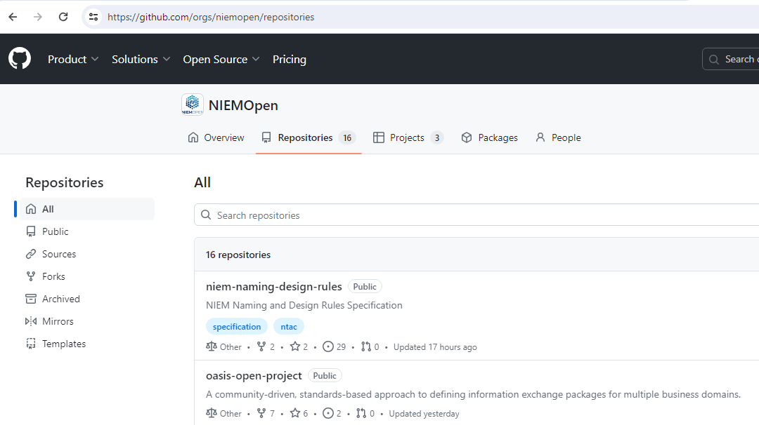
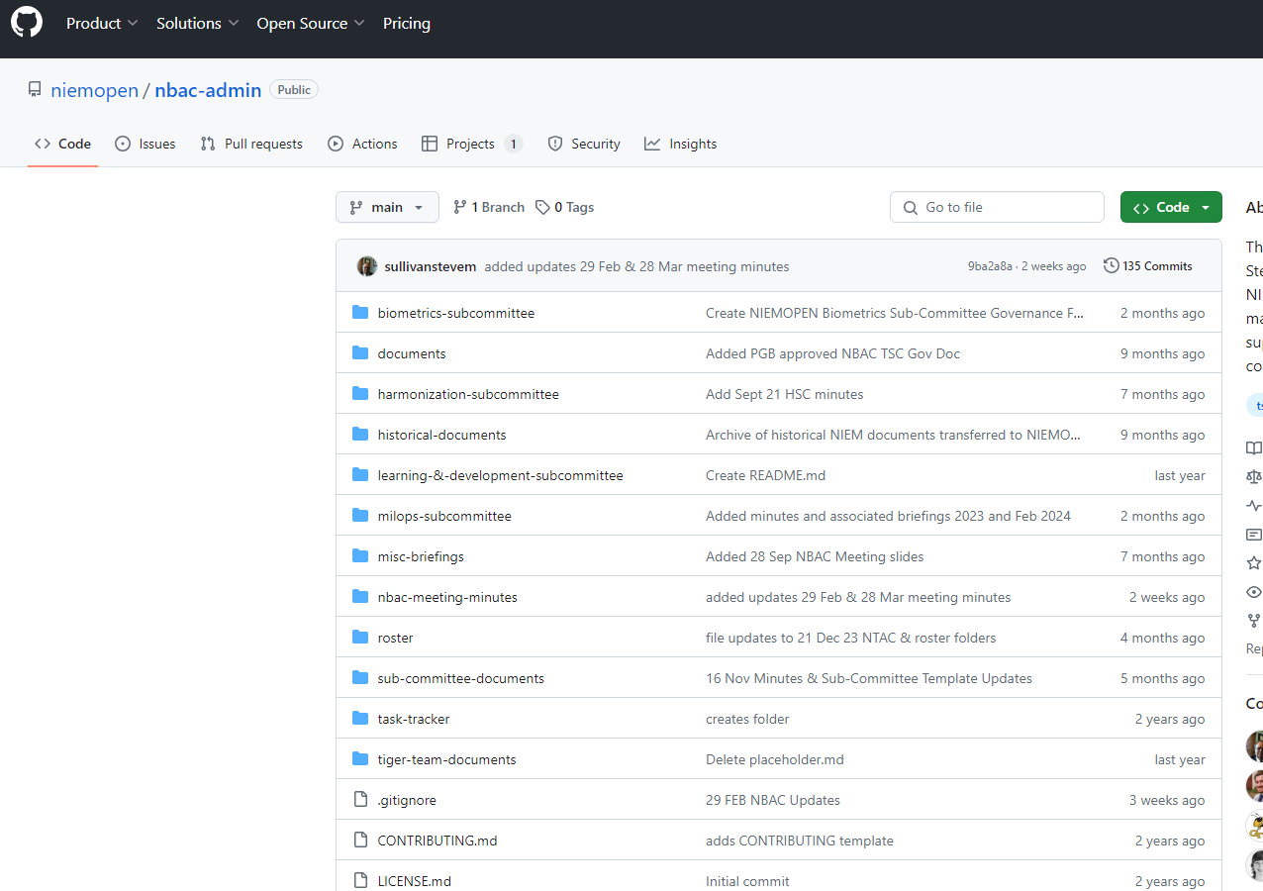
Repos
https://github.com/orgs/niemopen/repositories
NBAC Admin:
https://github.com/niemopen/nbac-admin

Slide 7
30 MAY 2024 NBAC TSC Agenda
1:15 MEP Tool Demo – Aubrey Beach
1:30 NTAC Update – Dr. Scott Renner
1:35 Communications & Outreach NMO Sub-Committee update – Paul Wormeli
1:40 Community Updates - all
1:45 Questions/Final Remarks

